Slide 1

VLSI Design of CRC-Based Fingerprinting on MIPS8 Architecture
Georgi Kostadinov, Xinchi Chen, Kaushik Boga, Mojing Liu
Department of Electrical and Computer Engineering
McGill University
Notes:
Hi,
My name is Mojing Liu and I am currently a master student at McGill University. Today I am here to present my research on the workload effects on execution fingerprinting for low-cost safety critical systems. This research was conducted under the GRC task 2371 alongside with the help from freescale semiconductor, my co-researcher Jonah and Georgi and also my professor Brett Meyer.

Slide 2
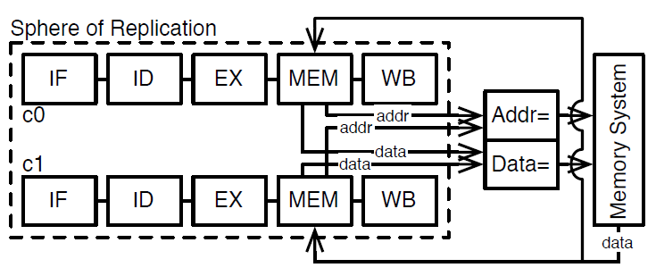
Background and Motivation
SER and MBU increase
Lockstep Execution: Area Overhead
Lockstep Execution
Notes:
This issue has been addressed before through the use of error correcting code or also error detecting codes. These code mainly consist of adding redundant data bits that are then compared to see if an error occurred. Most ECC techniques can greatly improve the reliability of a system but also impacts the performance. At each access of this data, the redundant data bits need to be computed and compared. Another solution widely used in industry is lockstep execution. Lockstep consist of two redundant processor execution the exact same application on two independent resources. The results are then compared and validated if they are the same. This take out the performance impact compared to the ECC approach but increases the cost by twofold. Furthermore, those safety critical tasks have dedicated critical resources, not accessible by non-critical tasks. They have been scheduled to allow a third run of the application in case of different results. This leads to waste in of computational resources with all those empty slots.

Slide 3
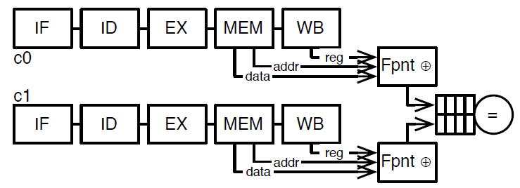
Execution Fingerprinting
Data Compression -> Less communication overhead
No Lockstep -> Better schedulability and performance
Execution Fingerprinting
Notes:
Here’s a flow chart of how fingerprinting works. First, a set of data is chosen to be monitored and extracted from the processor execution. Here we have the write address and data, the memory load address and all the register updates due to ALU operations. Upon a certain time of execution, these data are compressed using any sort of hashing algorithm such as CRC or fletcher’s checksum into fingerprint. Each fingerprint is associated with a certain execution timeline of the application. Theses fingerprints, are then stored inside the fingerprint comparator and compared with the fingerprints generated by the redundant run. This greatly reduces the comparison overhead compared with the lockstep technique where basically every execution data needs to be compared. This provides a lot of possible design that can be tuned to a particular type of application for instance. And this is why we are going to talk about how tunable is fingerprinting?

Slide 4
Approach
Fingerprinting in 3 easy steps:
Extract data from processor
Compress data into fingerprints
Store fingerprints for comparison
Notes:
Here’s a flow chart of how fingerprinting works. First, a set of data is chosen to be monitored and extracted from the processor execution. Here we have the write address and data, the memory load address and all the register updates due to ALU operations. Upon a certain time of execution, these data are compressed using any sort of hashing algorithm such as CRC or fletcher’s checksum into fingerprint. Each fingerprint is associated with a certain execution timeline of the application. Theses fingerprints, are then stored inside the fingerprint comparator and compared with the fingerprints generated by the redundant run. This greatly reduces the comparison overhead compared with the lockstep technique where basically every execution data needs to be compared. This provides a lot of possible design that can be tuned to a particular type of application for instance. And this is why we are going to talk about how tunable is fingerprinting?

Slide 5
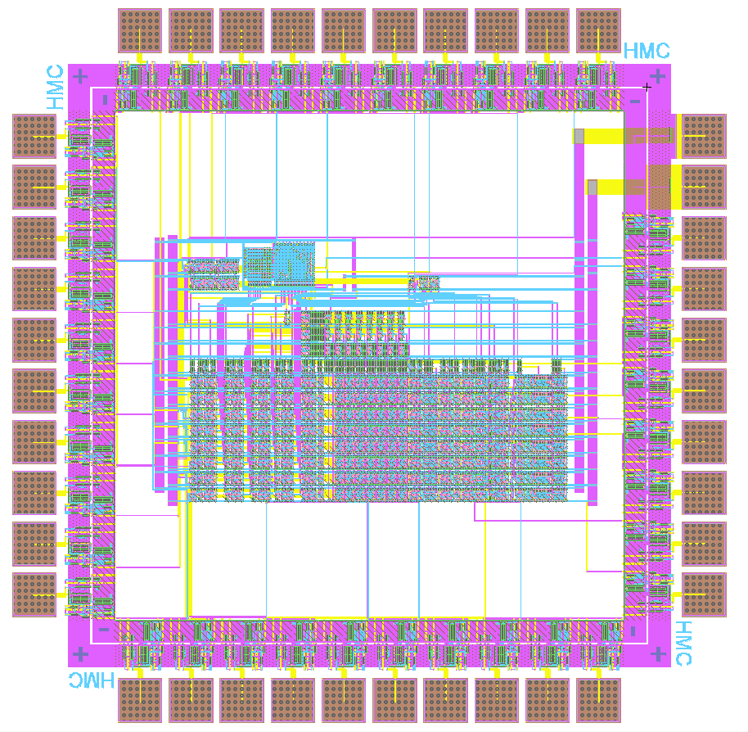
Extracting the Data
Memory write address and data
Register data
Other options also possible
Original MIPS8 packaging
9 additional pins (8 bit register data + register control signal)
Notes:
Here’s a flow chart of how fingerprinting works. First, a set of data is chosen to be monitored and extracted from the processor execution. Here we have the write address and data, the memory load address and all the register updates due to ALU operations. Upon a certain time of execution, these data are compressed using any sort of hashing algorithm such as CRC or fletcher’s checksum into fingerprint. Each fingerprint is associated with a certain execution timeline of the application. Theses fingerprints, are then stored inside the fingerprint comparator and compared with the fingerprints generated by the redundant run. This greatly reduces the comparison overhead compared with the lockstep technique where basically every execution data needs to be compared. This provides a lot of possible design that can be tuned to a particular type of application for instance. And this is why we are going to talk about how tunable is fingerprinting?

Slide 6
Compressing the Data
Algorithm of choice: CRC
CRC8 and CRC16
Parallel CRC
CRC Layout
Notes:
Here’s a flow chart of how fingerprinting works. First, a set of data is chosen to be monitored and extracted from the processor execution. Here we have the write address and data, the memory load address and all the register updates due to ALU operations. Upon a certain time of execution, these data are compressed using any sort of hashing algorithm such as CRC or fletcher’s checksum into fingerprint. Each fingerprint is associated with a certain execution timeline of the application. Theses fingerprints, are then stored inside the fingerprint comparator and compared with the fingerprints generated by the redundant run. This greatly reduces the comparison overhead compared with the lockstep technique where basically every execution data needs to be compared. This provides a lot of possible design that can be tuned to a particular type of application for instance. And this is why we are going to talk about how tunable is fingerprinting?

Slide 7
Storing the Fingerprints
Initial implementation: Shift Register
Drawbacks
Improved implementation: SRAM
Notes:
Here’s a flow chart of how fingerprinting works. First, a set of data is chosen to be monitored and extracted from the processor execution. Here we have the write address and data, the memory load address and all the register updates due to ALU operations. Upon a certain time of execution, these data are compressed using any sort of hashing algorithm such as CRC or fletcher’s checksum into fingerprint. Each fingerprint is associated with a certain execution timeline of the application. Theses fingerprints, are then stored inside the fingerprint comparator and compared with the fingerprints generated by the redundant run. This greatly reduces the comparison overhead compared with the lockstep technique where basically every execution data needs to be compared. This provides a lot of possible design that can be tuned to a particular type of application for instance. And this is why we are going to talk about how tunable is fingerprinting?

Slide 8
Evaluation - Timing
IRSIM
Notes:
Here’s a flow chart of how fingerprinting works. First, a set of data is chosen to be monitored and extracted from the processor execution. Here we have the write address and data, the memory load address and all the register updates due to ALU operations. Upon a certain time of execution, these data are compressed using any sort of hashing algorithm such as CRC or fletcher’s checksum into fingerprint. Each fingerprint is associated with a certain execution timeline of the application. Theses fingerprints, are then stored inside the fingerprint comparator and compared with the fingerprints generated by the redundant run. This greatly reduces the comparison overhead compared with the lockstep technique where basically every execution data needs to be compared. This provides a lot of possible design that can be tuned to a particular type of application for instance. And this is why we are going to talk about how tunable is fingerprinting?

Slide 9
Evaluation – Timing
Initial implementation: Shift Register
Drawbacks
Improved implementation: SRAM
Notes:
Here’s a flow chart of how fingerprinting works. First, a set of data is chosen to be monitored and extracted from the processor execution. Here we have the write address and data, the memory load address and all the register updates due to ALU operations. Upon a certain time of execution, these data are compressed using any sort of hashing algorithm such as CRC or fletcher’s checksum into fingerprint. Each fingerprint is associated with a certain execution timeline of the application. Theses fingerprints, are then stored inside the fingerprint comparator and compared with the fingerprints generated by the redundant run. This greatly reduces the comparison overhead compared with the lockstep technique where basically every execution data needs to be compared. This provides a lot of possible design that can be tuned to a particular type of application for instance. And this is why we are going to talk about how tunable is fingerprinting?

